Slide 1

Beyond Vision
Beniamin
Tech enthusiast &
Hardware researcher
3nd year Computer engineering student
Advisor:
Alin Grama

Slide 2

Steganography
Steganography is the art and science of sending covert message and the existence of these messages are only known by the sender and the receiver.
This technique has been practiced for thousands of years.

Slide 3


Benefits of steganography
Highly securely
Could be very useful in copyright

Slide 4
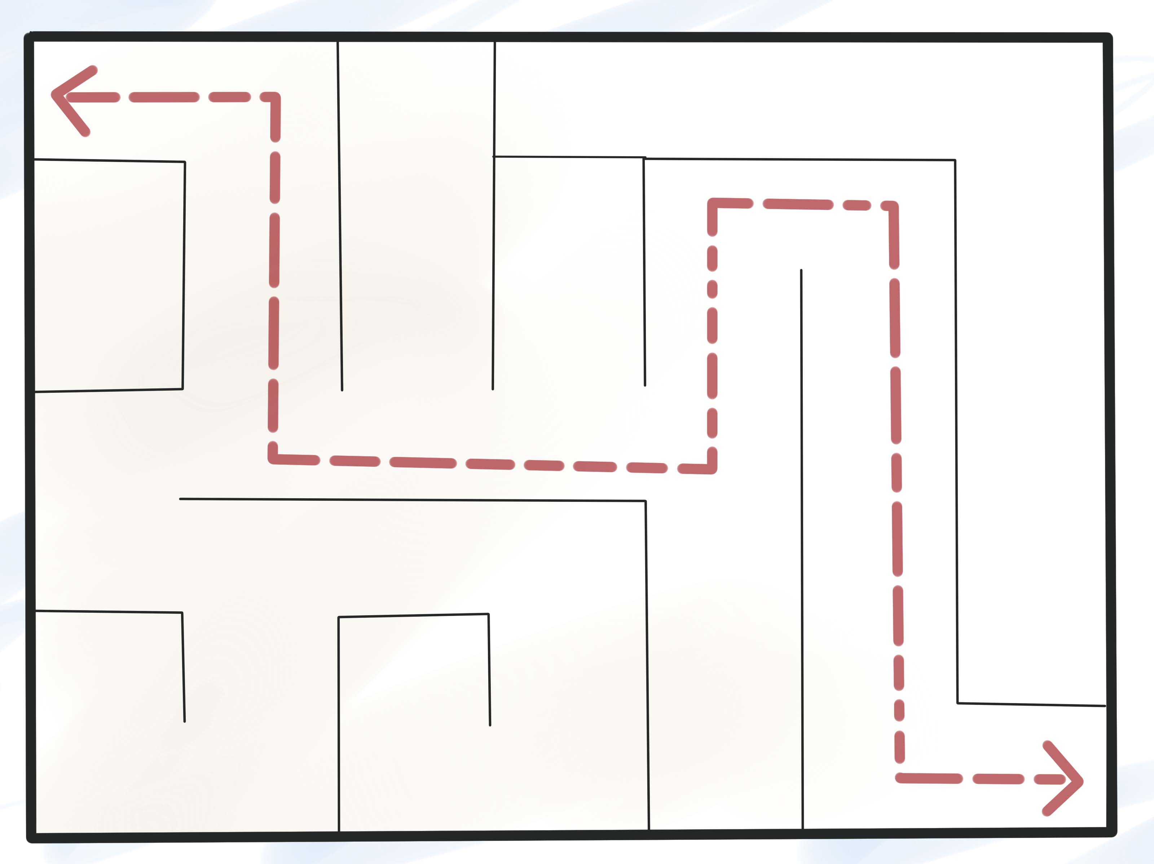

Benefits of steganography
Could not be traced
Allows encrypted communicates without being detected

Slide 5
Is steganography really useful?
British Prime Minister Margaret Thatcher used this to identify the internal informer
US and USSR were transmitting information about nuclear facilities on public channels without revealing the receiver location
You may not be the only one reading your private messages on social media, steganography can stop it

Slide 6
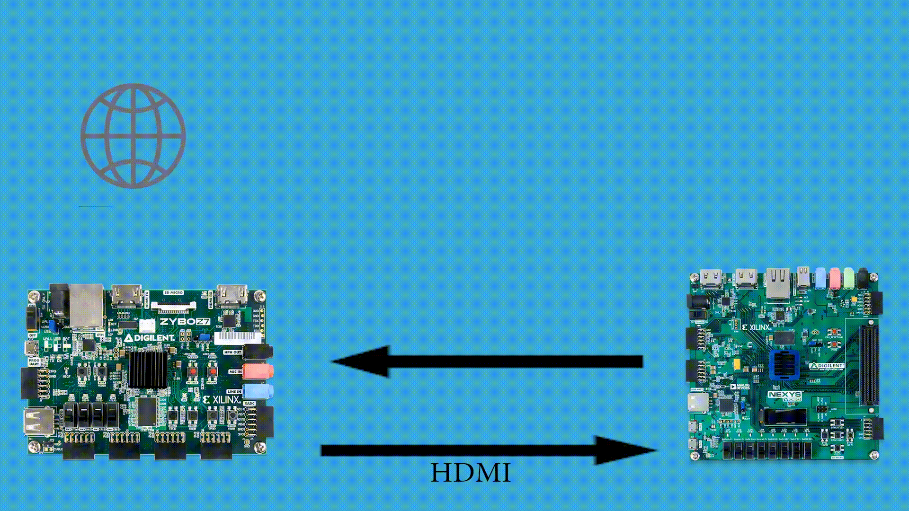
My solution
A highly secure server which is hardware accelerated to embed and extract hidden data inside images, sound and encrypt data faster

Slide 7
Linux Kernel for Zybo ARM processor
Web server running on Linux
Highly scalable
Custom Linux Kernel drivers developed for hardware components

Slide 8
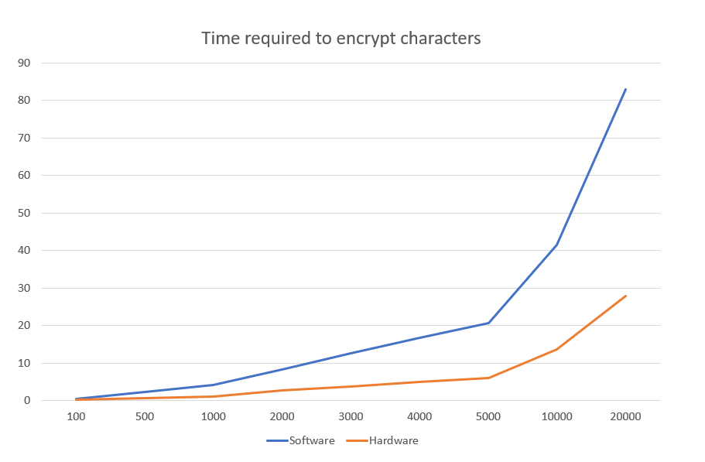
Hardware accelerated
Receives data via AXI Stream
Custom Linux Kernel driver for it
> 250 % faster
RSA Encrypter/ Decrypter

Slide 9
True Random Number Generator
Hardware accelerated
Receives random locations from Linux Kernel via AXI Stream
Receives chip temperature
Custom Linux Kernel driver for it

Slide 10
Hardware accelerated
Receives data via HDMI in
Broadcast it via HDMI out
Custom Linux Kernel driver to interact with VDMA
> 36 times faster
Video Processing unit on Nexys Video

Slide 11
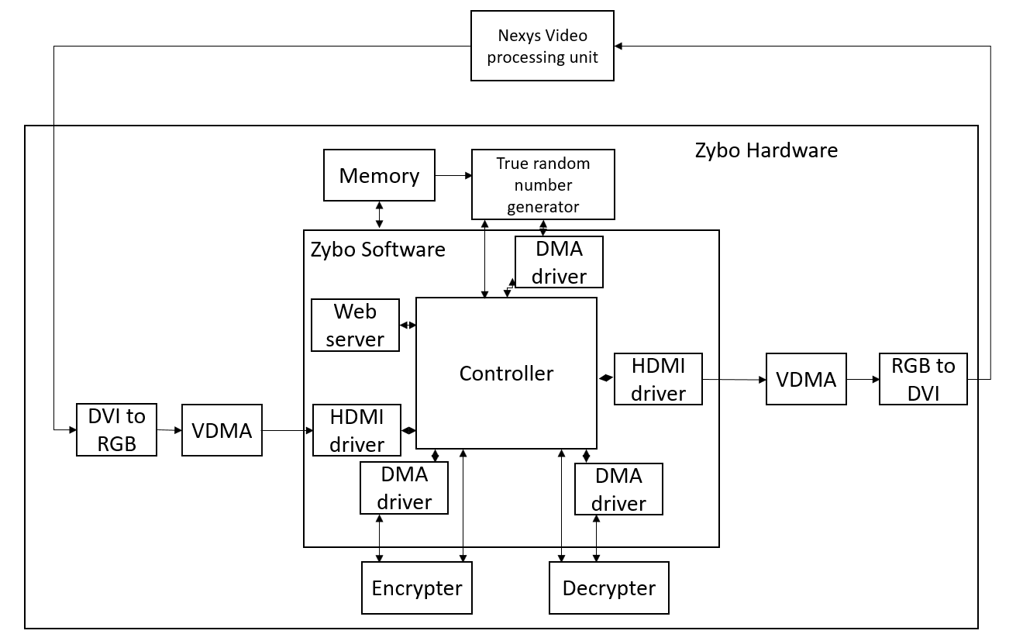
So how does it work?

Slide 12
Performance > 300% faster

Slide 13
Comparison
 | Medium computer CPU + Memory + Motherboard + Power supply + Storage + Case | ARM/FPGA
Price | > 2000 lei | 1600 lei
Power on load | >300W | 4.1W
Monthly cost | > 200 lei | 10 lei

Slide 14

Main features?
Hardware accelerated:
Cryptography algorithms (RSA)
Image Steganography
Sound Steganography
True random number generator for generating certificates
External HDMI video processor
Easily integrated with exposed API
Chat App integrated
Real time operating system
Drivers for Linux Kernel developed

Slide 15
Development Stages
Exploring possibilities
and research
Develop HDMI processing unit
Build hardware for Linux Kernel
Modifying and compiling Linux
Develop Linux module to work with HDMI
Create hardware modules for encryption and decryption
Create hardware modules for random generator
Web service
Presentation
Refactoring

Slide 16
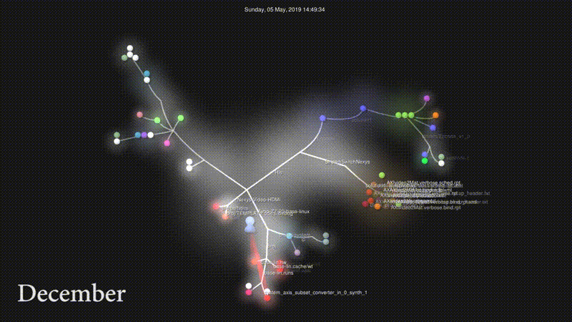
56 days
100%
Competition started
Final evaluation
41 days
Dec 7
HDMI in Linux
Prototype working
May 05
50%
Linux
50 days
2018
2019
38%
Dec
Jan
Feb
Mar
Apr
May
210 days
40%
Research
Today
26 days
Research
Dec 7 - Jan 1
HDMI processing unit
35 days
HDMI processing unit
Dec 10 - Jan 18
Linux Kernel Hardware + Modifying
Linux Kernel
HDMI driver
Jan 2 - Jan 25
Software Steganography
HDMI Driver
Jan 23 - Mar 1
Steganography
Feb 25- Mar 15
Encrypter / Decrypter/ Random
Encrypter + Decrypter + Random Generator + Drivers
Feb 27 - Apr 24
Documentation + Presentation
Merging + Documentation + Presentation
Mar 1 - May 5

Slide 17
Further development
Parallelization more the encryption and decryption to get better performances
Optimize architecture
Accelerate multiple video algorithms

Slide 18
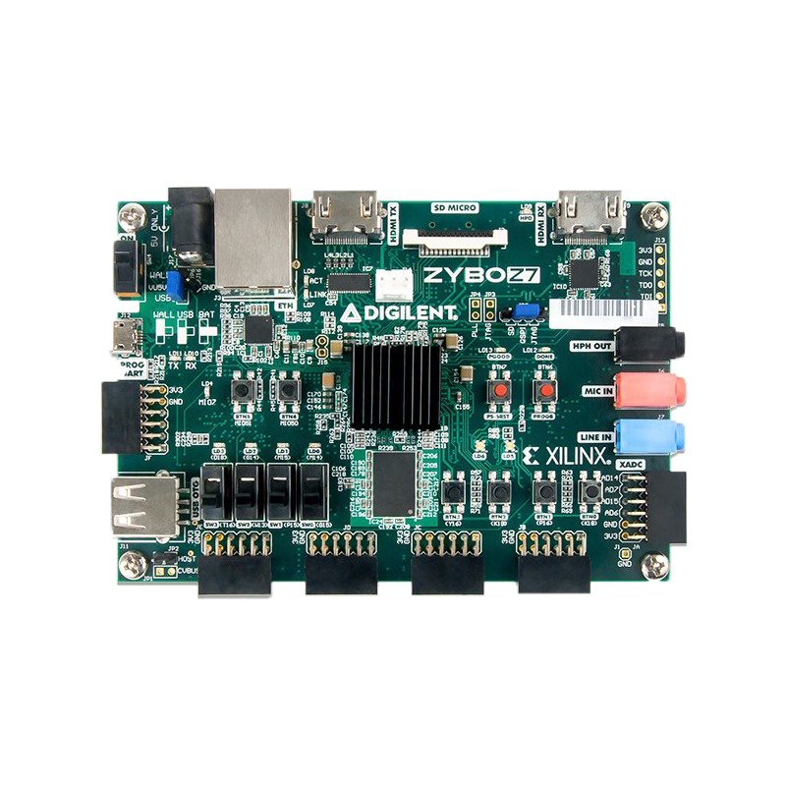



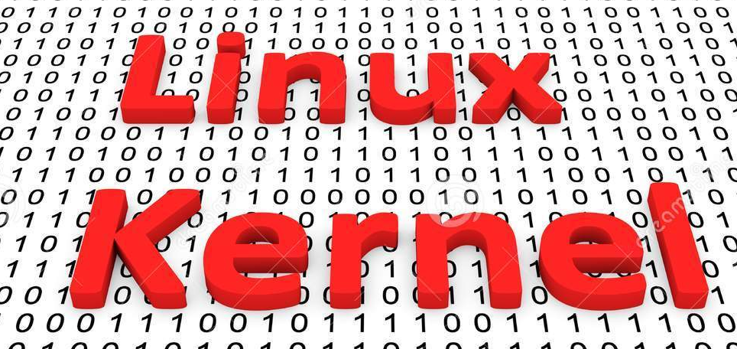

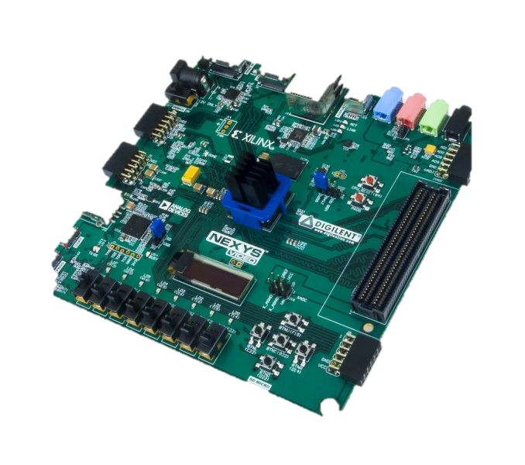
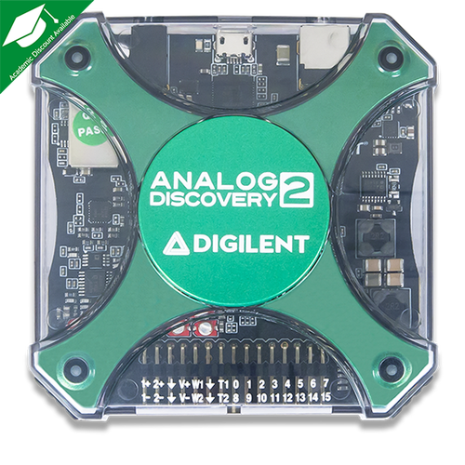




What I used in order to create the platform:
MADE FROM SCRATCH
Notes:
In order to develop this we have used: POZE CU LOGOURI SI ZENZORI <- DE ADAUGAT

